Slide 1
Common Metadata Framework for Trusted AI
HPE AI Research Lab, Data Foundation for AI project team
Annmary Justine, Aalap Tripathy, Sergey Serebryakov, Cong Xu, Suparna Bhattacharya, Martin Foltin, Paolo Faraboschi
6/23/2022

Slide 2
Agenda
Data Foundation for AI
Common Metadata Framework (CMF)
Architecture
Integration with ecosystem of ml frameworks and ml tracking platforms

Slide 3
Self-Learning Data Foundation for trustworthy AI
A separate software Layer between MLOps Platforms and Storage (agnostic to both)
Example AI Pipeline (running on Pytorch Lightening, MLFlow, Kubeflow, etc., MLOps Platform)
Motivation
Building Trustworthy AI models can stress infrastructure and requires significant human effort
Focus shifting from optimizing AI models to co-optimizing the data selection (good data rather than big data), labeling, transformations and models
Optimization scope expanding from few pipeline stages (AI model training and test) to many stages, and across different pipelines
Optimizations carried out for more metrics than before: besides model accuracy, the Trust features (robustness, explainability, and fairness) are critical
Meeting Trust objectives while co-optimizing AI models and data in complex pipelines requires infrastructure for tracking and managing data lineage and pipeline metadata
Drift Detection and Retraining
Model Templates
Anomaly Templates
Training Data
Inference Data
Model Experiment 1
…
Data Selection
Data Transformation
Data Validation
Model Experiment n
Active Learning
Model Validation
Model Serving
Model Monitoring
Metadata
Insights
Northbound Connectors and Intelligence
Git for AI Common Metadata Framework (CMF) Metadata : Git; Data, Artifacts : DVC
Southbound Connectors and Intelligence
Metadata
Insights
Public Cloud
External enterprise
On-prem HPC Data Center
Local
Edge
Storage
Data Fabric e.g. Lustre, HDFS, MapR, DMF

Slide 4
Tracking and Managing Metadata in the Era of Data-centric AI
COMMON METADATA FRAMEWORK - Tracking metadata for complex linked AI pipelines
Representative AI Pipeline
Challenges
Multiple stages with interlinked dependencies and each stage could be executed in distributed asynchronous mode.
Data centricity requires artifact lineages and tracking influence of different artifacts and data slices on model performance.
Pipelines should be Reproducible , Auditable and Traceable.
Legend
:
Training
Metadata
(
green
)
Data
(
blue
)
Labeling
Training
Validation
Model
(
purple
)
New Simulation or
Data
Model
Experimental Data
Store
Store
Git for AI Common Metadata Framework (CMF) Metadata : Git; Data, Artifacts : DVC
Single Model
Model Ensemble
Serving
Inference
Uncertainty
Diversity
Learning
Quantification
Assessment
Strategy
Uncertainty
Calibration
Data Slice L
1
:
Data Slice L
2
:
Data Slice L
3
:
Data Slice L
4
:
Calibration Samples
Informative Samples
Diverse Samples
Selected Samples

Slide 5
Common Metadata Framework (CMF)

Slide 6
ML METADATA TRACKING TOOLS
MLFLOW TRACKING
MLMD
CMF
COLLABORATIVE DEVELOPMENT
Git like Support | No | No | Yes
DATACENTRIC SUPPORT
Integrated Versioning | No | No | Yes
Identified by | Path / ID |  | Uniquely Identified by Hashes
Subset Identification | No | No | Yes
METRICS TRACKING
Fine grained experiment tracking metrics | Yes | No | Yes
PIPELINE METADATA
Pipeline Lineage | No | Yes | Yes

Slide 7
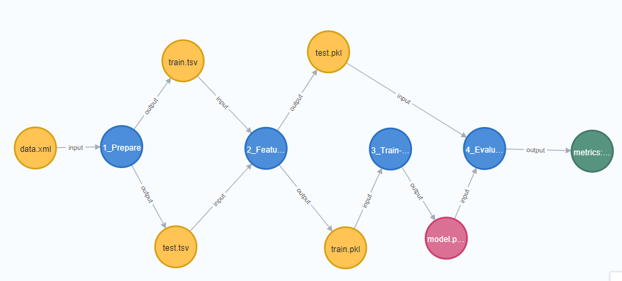
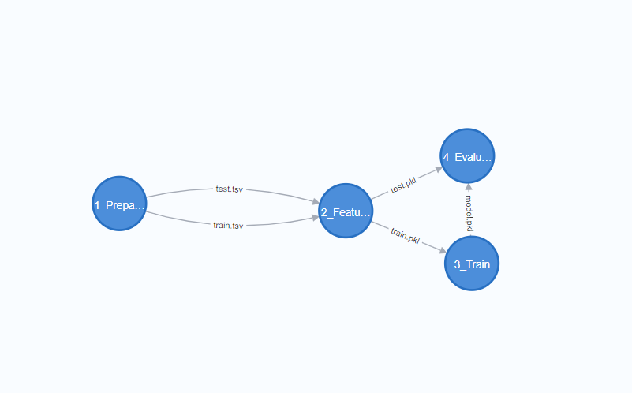
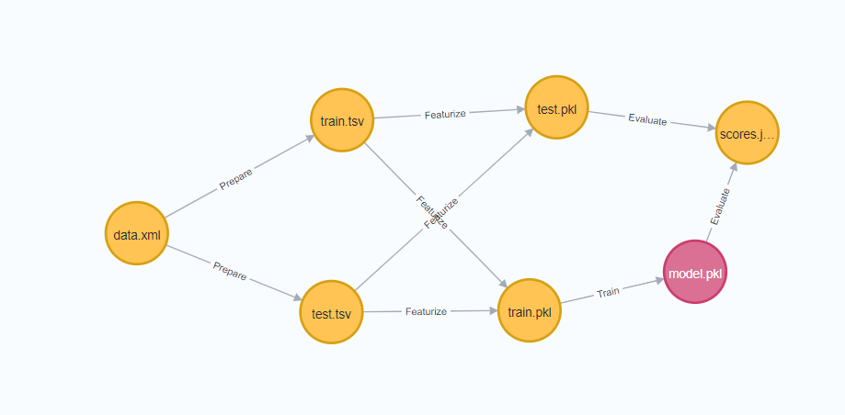
CMF Tracks both execution and artifact Lineage
Lineage stored as DAGs , Provenance
Lineage DAG
CMF Tracks both execution and artifact Lineage
Execution Lineage
Artifact Lineage

Slide 8
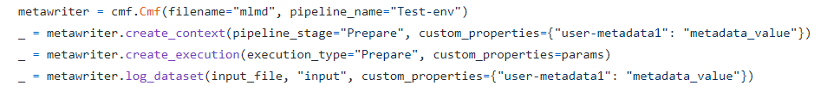
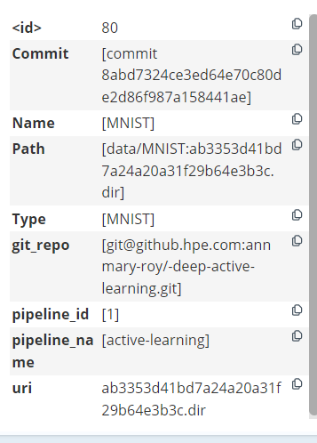
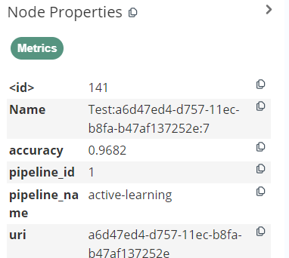
COMMON METADATA FRAMEWORK
Faster development of Models, increasing efficiency for Data Scientist, Accelerating new Science
Python library
Decentralized usage model, easily cloned in any environment
Example Metadata Collected
Decentralized usage model, easily cloned in any environment
Remote Storage (data, models)
2. Pull to local repo
1. Push to central repo
Metadata Repository
Git Repository (code)
3. Augment / Clean and push to remote
4. Modified data & metadata available for consumption
Notes:
Some more grounding on active learning is needed . Legends consistent . Mention it’s a python library . Code snippet from library . Build the complicated lineage graph progressively

Slide 9
Common Metadata Framework (CMF) Architecture
UNIFIED MANAGEMENT OF CODE, DATA AND METADATA
COMMON METADATA FRAMEWORK
Logging Engine
( Explicit and Implicit Tracking)
Optimization Engine
Rest API
API
Distribution Layer
Metadata Store
(MLMD/ MLFlow)
Artifact
Store
( DVC
/Others)
GIT
Query Cache Layer
(Graph Database)
Query Engine
Rest API
Common Metadata Framework
Existing Frameworks
In Development
Text

Slide 10

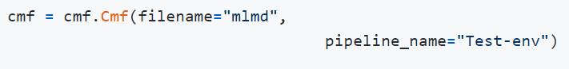
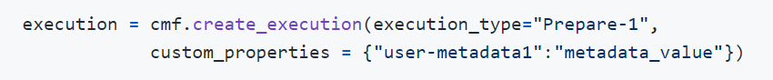
Cmf api
Pipeline, Stage, Executions, Asynchronous and distributed
Execution
Pipeline
Context/Stage
Execution
Execution

Slide 11

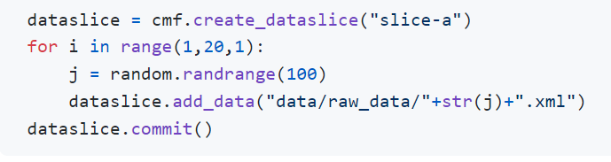
CMF API
Stored in content addressable repo with help of DVC + GIT
Versioned Automatically
Identified by content hash
Dataset
Dataslice
Model

Slide 12

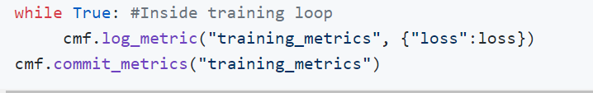
CMF API
Scalable
Support for Consolidated output metric and fine drill down to per step metrics
Metrics

Slide 13
Integration with ecosystem of ML frameworks and ML tracking platforms

Slide 14
Proof-of-concept implementations
ML/DL frameworks
ML Tracking Platforms
Callbacks mechanism
Autologging
CMF
Fully-functional backends
External references

Slide 15
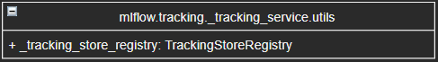
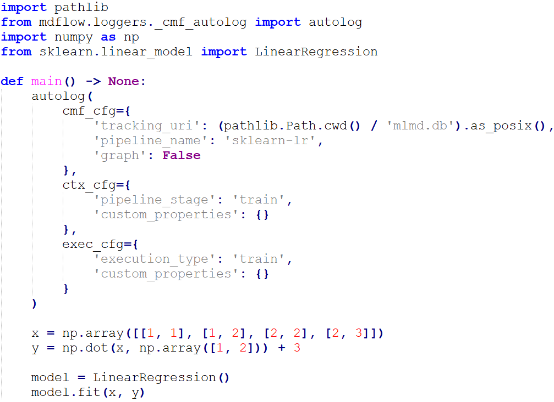
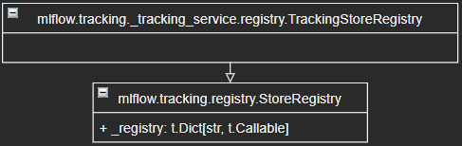
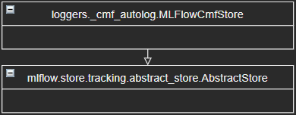
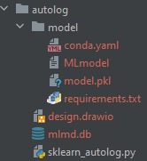
Autologging with ML/DL frameworks
MLflow (and other frameworks) already integrate with many Machine Learning and Deep Learning frameworks. Let’s try to use it!
MLflow components related to backend stores
Code example
CMF implements and registers its own backend store
that maps a name of a store to its implementation
Standard scikit-learn code
Enable autologging
(“from cmf import autolog”)
MLflow has a registry of metadata stores

Slide 16
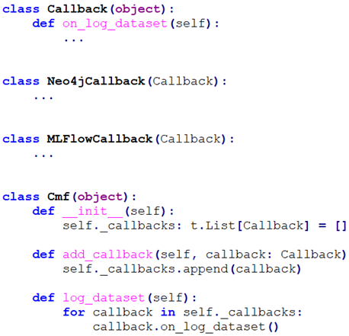
Integration with tracking platforms: callbacks
Reporting: integration via callbacks.
Idea: similar to how Ray Tune integrates with MLflow (one example).
Status: PoC implementation
How: call any registered callback whenever CMF API is called.
Why: could be useful for visualization and quick analysis with standard MLflow tools (search …).
Important: CMF uses its own metadata (MLMD) and artifact(DVC) stores as primary store options.

Slide 17
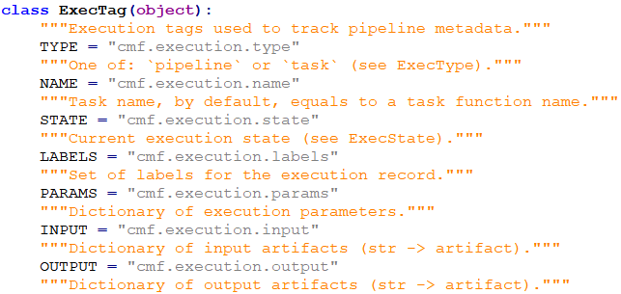
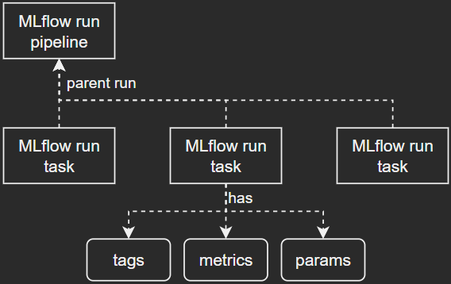
Integration with tracking platforms: fully-functional backends
Fully-functional backends to replace MLMD.
Idea: similar to how MLflow can use different backends (FileStore, RestStore and SqlAlchemyStore).
Status: MLflow-based PoC implementation with limited features available.
How: completely replace MLMD backend with something else (e.g., MLflow).
Why: Organizations and teams may already be using some tracking library.
Important: Could be tricky to support all features available in MLMD, maybe does not make too much sense (need to be opinionated about certain things).

Slide 18
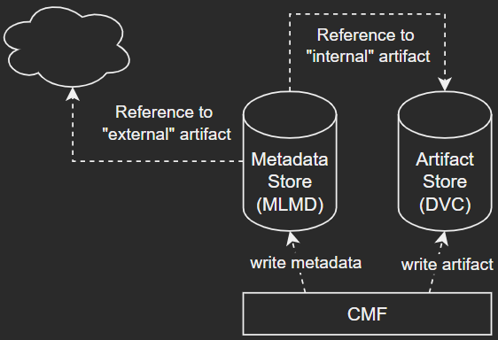
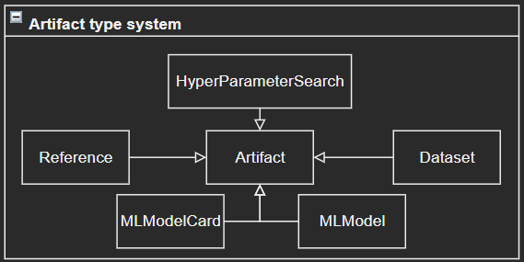
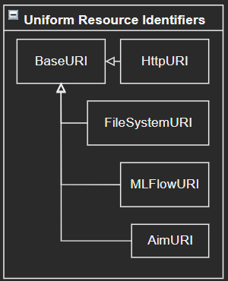
Integration with tracking platforms: external references
Referencing externally-hosted artifacts.
Idea: let MLflow, AIM or W&B host artifacts, parameters and metrics for all or subset of pipeline tasks.
Status: MLflow-based PoC implementation available, AIM-based PoC is in progress.
How: introduce new API to CMF, e.g., log_artifact. Idea is to use an artifact type system.
Why: Organizations and teams may already be using some tracking libraries.
Important: CMF just references external artifacts; it does not own them.
MLflow
W&B
AIM
Uniform Resource Identifiers (URIs) are used here
https://storage.com/tf-keras-datasets/mnist.npz
file:///C:/Users/ds/.cmf/data/mnist/mnist.npz
mlflow:///runs/e4066de5ff3840a98f00e9314eac3ac5/mnist.npz
mlflow:///experiments/2?tags.ray.run_name=%22RUN_ID%22
mlflow:///models/cdu_01/production
aim:///runs/RUN_HASH

Slide 19
Thank you
annmary.roy@hpe.com
aalap.tripathy@hpe.com
sergey.serebryakov@hpe.com
cong.xu@hpe.com
suparna.bhattacharya@hpe.com
martin.foltin@hpe.com
paolo.faraboschi@hpe.com

Slide 20
CMF Demo
Notes:
Toy example with more scenarios: Different hyper-parameters. Different versions of the same dataset.
Lead to more complex use cases
Data transformation after serving: opportunistic

Slide 21

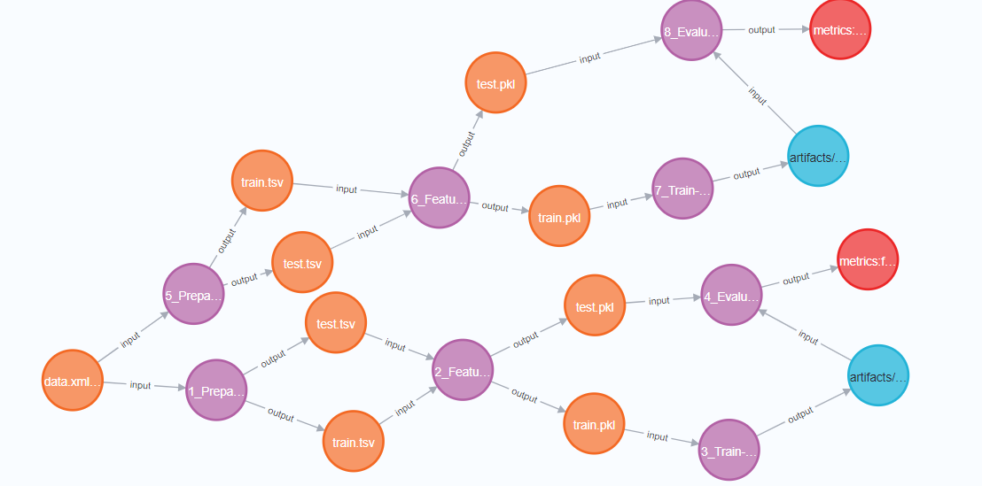
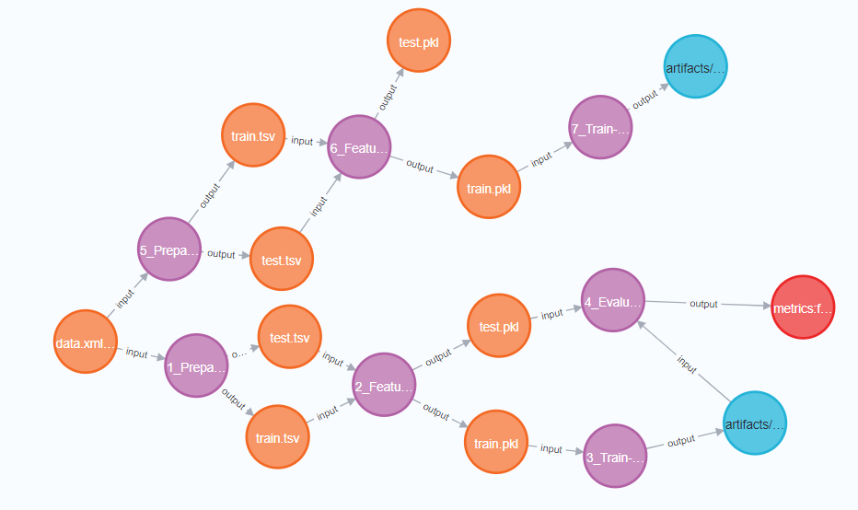
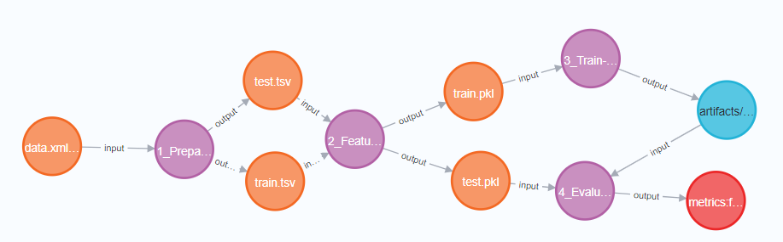
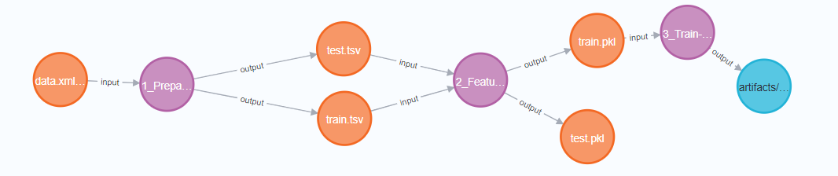


CMF DEMO
COLLABORATE ON A PIPELINE AND SHARE METADATA
Text classification with Random Forest Classifier
Data Preparation
Local Git Clone
(Code, DVC Files, MLMD)
Local Git Clone
(Code, DVC Files, MLMD)
Evaluate
Feature Extraction
Train

Slide 22
Use Cases

Slide 23
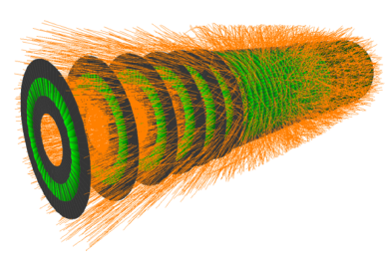
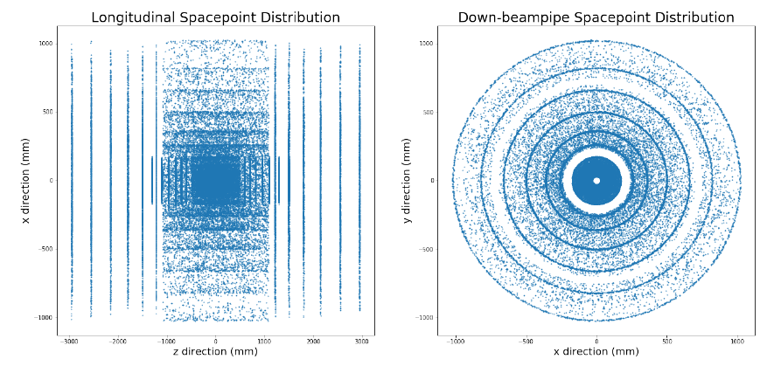
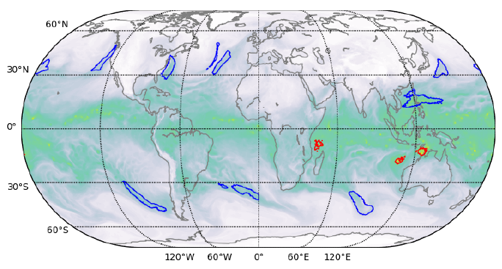
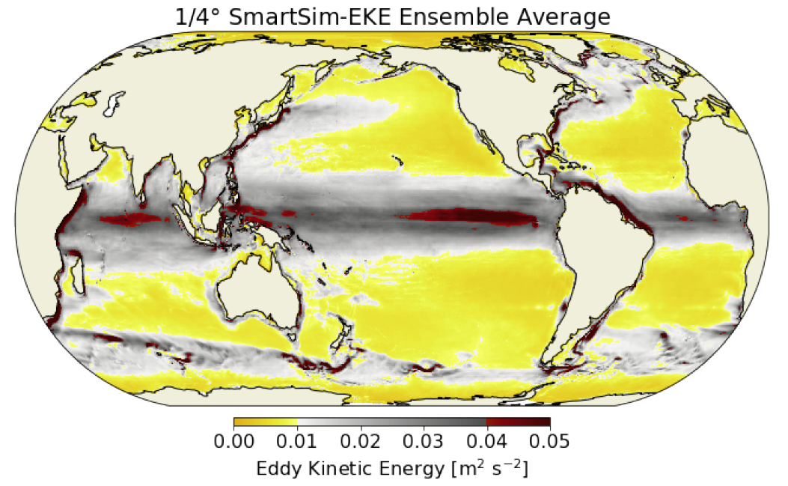
Objectives
Faster development of Trustworthy AI models in complex pipelines
Reduction of AI model training time • Trustworthy AI models for acceleration of complex simulations
Reduction of data labeling effort for supervised learning (looking for collaboration opportunities)
Reduction of experiment or simulation data volume required to build Trustworthy AI models
Exa.trkX High Energy Physics Particle Trajectory Reconstruction
(Problem example from Eur. Phys. J. C 81 (2021), 876 and arXiv 2103.06695 by Ju et. al.)
DeepCam Extreme Weather Feature Identification
Ocean Climate Modeling MOM6 with EKE Surrogate Models
(Problem example from SC’18 and arXiv 1810.01993 by Kurth et. al.)
(Problem example from arXiv 2104.09355 by Partee et. al.)

Slide 24
Problem Statement
Building Trustworthy AI models often requires large volumes of data, stressing AI compute and storage infrastructures and requiring significant human efforts to label the data and optimize AI models
Example: DeepCam
Optimization scope expanding from few pipeline stages (AI model training and test) to many stages, and across different pipelines
Example: Exa.Trkx
Optimizations carried out for more metrics than before: besides model accuracy, the Trust features (robustness, explainability) are critical
Example: Ocean Climate Modeling
Focus shifting from optimizing AI models to co-optimizing the data selection (good data rather than big data), data labeling, data transformations, and AI models (the Data-centric AI paradigm)
Meeting Trust objectives while co-optimizing AI models and data in complex pipelines requires:
infrastructure for tracking and managing data lineage and pipeline metadata
intelligence to learn from this metadata to optimize data and pipelines

Slide 25
Example Use Case 1
Faster development of Trustworthy AI models in complex pipelines
Reduction of AI model training time • Trustworthy AI models for acceleration of complex simulations
Reduction of data labeling effort for supervised learning (looking for collaboration opportunities)
Reduction of experiment or simulation data volume required to build Trustworthy AI models
Exa.trkX High Energy Physics Particle Trajectory Reconstruction
(Problem example from Eur. Phys. J. C 81 (2021), 876 and arXiv 2103.06695 by Ju et. al.)
DeepCam Extreme Weather Feature Identification
Ocean Climate Modeling MOM6 with EKE Surrogate Models
(Problem example from SC’18 and arXiv 1810.01993 by Kurth et. al.)
(Problem example from arXiv 2104.09355 by Partee et. al.)

Slide 26
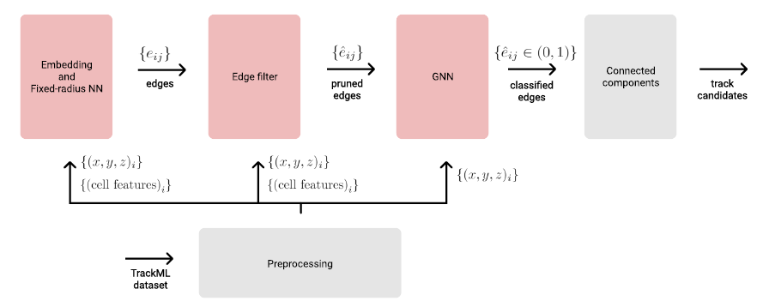
Exa.trkX High Energy Physics Particle Reconstruction
Challenges
Space-point formation
Track Seeding
Track Following
Track Fitting
Track candidates
Offline Particle Tracking
(Physics-based/Deterministic. Large computational cost. Slow)
Collider Experiments
High Luminosity Large Hardon Collider (HL-LHC), ATLAS, CMS, …..
Source: Ju, Murnane et al. Performance of a Geometric Deep Learning Pipeline for HL-LHC Particle Tracking, Eur. Phys. J., 2021
Online Particle Tracking
(GNN/Metric Learning Particle Tracking Algorithms)
Particle Tracking algorithm
Linked experiment stages: Many execution lineages, artifact lineages, metrics, models, and config parameters
Long experiment times
Purity-efficiency tradeoff

Slide 27
Instrumenting Exa.trkX HEP Particle Reconstruction Pipeline with CMF
Branch: Image Processing & RNN’s
Branch: LSTM to suppl. Kalman Filter
Branch: Gated Recurrent Units
Branch: Graph Reconstruction
Metric Learning/Similarity Hashing
Global Services
GitHub
Metadata Hub
TrackML Dataset
Pre-processing
Embedding
DNN
ε- ball query
Edge Filter DNN
Edge Classification GNN
Triplet Classification GNN
Trajectory Reconstruction
Future: ATLAS, CMS, DUNE, ICARUS etc.
Experiment Management
TrainTrack
Custom Logger for TensorBoard, WnB and CMF
PyTorch Lightning
SimpleSlurm
AI Tools & Libraries
PyTorch 3D
PyTorch
PyTorch Geometric
Visualization Engine
Common Metadata Framework
Workflow Integrations (Northbound)
DVC
MLMD
Graph DB
Infrastructure Integrations (Southbound)
HPC Cluster
Parallel File System

Slide 28
Enabling AI MODEL OPTIMIZATION FOR COMPLEX LINKED AI PIPELINES
Faster development of Models, increasing efficiency for Data Scientist, Accelerating new Science
CMF helps tracks dependencies of output Metrics on Parameters across all variations of pipeline stages
Capturing data lineage, metrics, network architecture & parameters enables end-to-end visibility, reproducibility, and drives optimization
Experiment Variants
Chosen Variant
Other Variants
Pre-processing
Embedding
DNN
ε- ball query
Edge Filter DNN
Edge Classification GNN
Triplet Classification GNN
Trajectory Reconstruction
Parameters:
Latent Space dimension d
Distance Threshold ε
Model Architecture Probability Threshold t
Model Architecture nlayers-in, ndims-hidden nlayers-edge, ndims-hidden nlayers-node, ndims-hidden niter
Reconstruction efficiency
Purity
Inference run time
Metrics:
Metadata: Data Foundation Common Meta-data Layer

Slide 29
Example Use Case 2
Faster development of Trustworthy AI models in complex pipelines
Reduction of AI model training time • Trustworthy AI models for acceleration of complex simulations
Reduction of data labeling effort for supervised learning (looking for collaboration opportunities)
Reduction of experiment or simulation data volume required to build Trustworthy AI models
Exa.trkX High Energy Physics Particle Trajectory Reconstruction
(Problem example from Eur. Phys. J. C 81 (2021), 876 and arXiv 2103.06695 by Ju et. al.)
DeepCam Extreme Weather Feature Identification
Ocean Climate Modeling MOM6 with EKE Surrogate Models
(Problem example from SC’18 and arXiv 1810.01993 by Kurth et. al.)
(Problem example from arXiv 2104.09355 by Partee et. al.)

Slide 30
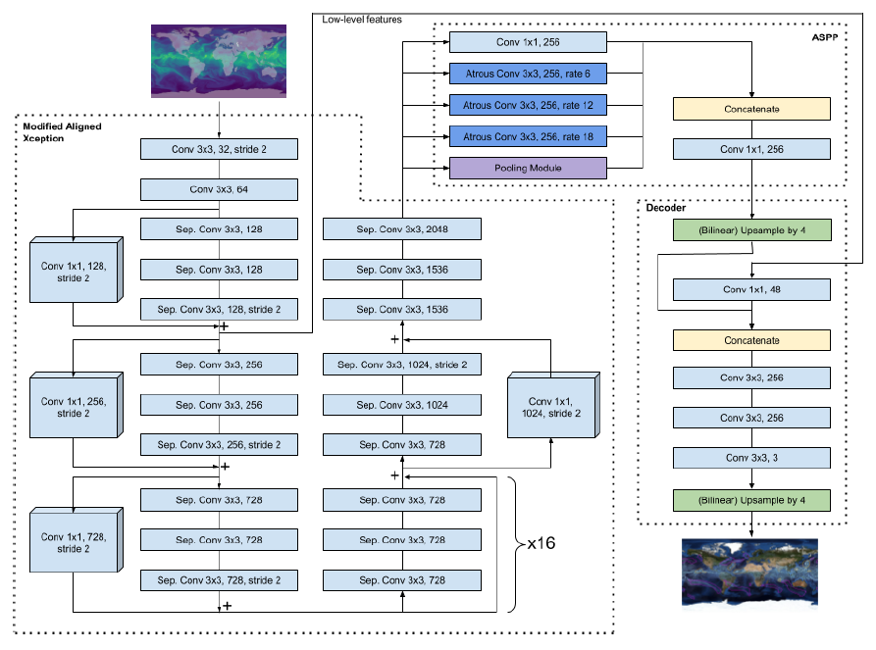
DeepCam atmospheric image segmentation
Challenges
Long model training time
I/O data movement bottleneck: 57 MB/image, 6.3 TB/dataset
Complex model: >6 GB GPU memory, ~3 TFLOP forward pass
High labeling effort and Lack of uncertainty quantification
Disparity of labels from different auto-labeling tools
Inference mean IoU quality of only ~0.73
Labeled Atmospheric rivers (blue) and tropical cyclones (red) (Kurth et. al., SC’18 and arXiv 1810.01993)
Complex climate segmentation model - DeepLabv3+ (Geosci. Model Dev. 14, 107-124, 2021 : gmd-14-107-2021)

Slide 31
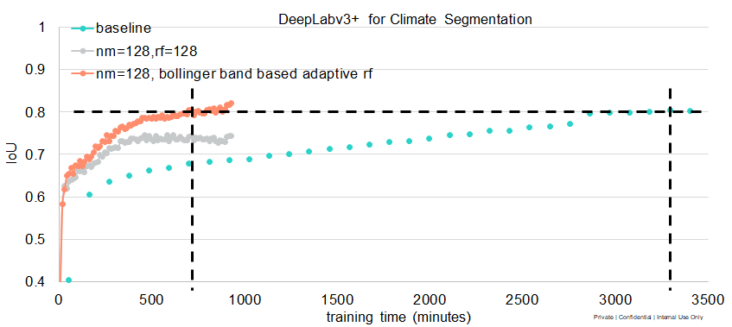
DeepCam atmospheric image segmentation
Reduce model training time
Model training can be storage I/O bandwidth limited
Bandwidth and data aware, and training convergence conscious training computations hide data movement latency
Data Foundation intelligence monitors accuracy to adjust computation repeating factor dynamically
Example: ~4x training time reduction on 4-nodes from Cori-GPU: 930 GB, 6.8 GB/s NVMe / node, 500 MB/s HDD / node
GPUs
Bandwidth B1 > B2
Control early stopping (rf), etc.
Mini-epoch i
Mini-epoch i+1
Performance Tier
4x training time reduction
Bandwidth B2
Data Foundation
Capacity Tier
(http://www.pdsw.org/pdsw21/papers/ws_pdsw_paper_S3_P1_paper-xu.pdf)

Slide 32
Example Use Case 3
Faster development of Trustworthy AI models in complex pipelines
Reduction of AI model training time • Trustworthy AI models for acceleration of complex simulations
Reduction of data labeling effort for supervised learning (looking for collaboration opportunities)
Reduction of experiment or simulation data volume required to build Trustworthy AI models
Exa.trkX High Energy Physics Particle Trajectory Reconstruction
(Problem example from Eur. Phys. J. C 81 (2021), 876 and arXiv 2103.06695 by Ju et. al.)
DeepCam Extreme Weather Feature Identification
Ocean Climate Modeling MOM6 with EKE Surrogate Models
(Problem example from SC’18 and arXiv 1810.01993 by Kurth et. al.)
(Problem example from arXiv 2104.09355 by Partee et. al.)

Slide 33
DeepCam atmospheric image segmentation
Reduce data labeling effort. Quantify prediction uncertainty
Active Learning: start with baseline data set, incrementally improve model quality
Provides guidance which input samples are of highest value for labeling and retraining
Will be combined with weakly-supervised learning to account for labeling uncertainty
Data Foundation benefits
maintains audit trail
enables model rewind
performs UQ calibration in the background
in the future, will update Learning Strategy based on performance of similar models and data
Target: >75% reduction in data labeling effort
Looking for future collaboration opportunities

Slide 34
Realizing CMF in End to end HPC Environments

Slide 35
End-to-end DATA Workflows: SUPERFACILITY MODEL
Experiment Campaign & Data Analysis at “Edge of Compute” (Today)
Setup Experimental Campaign
- Run simulations
2. Analyze Simulated Data
- Define Experimental Params
- Reserve Instrument Time
5. Data Transfer via Globus/DTN
(3) Store-forward
DTNs
HPC Simulation Workflow
7. Experimental Data Post Processing
7.1 Data Visualization
7.2 Data Publication (backed by HPC PFS)
7.3 Data Archiving
HPC Exascale Cluster
LBNL Spin (Rancher K8S) Cluster
Particle Accelerator
(LCLS)
6. Data Ingested to PFS
Management & Orchestration
Superfacility API
3. Data acquisition at Experimental Facility
Job Scheduling system
(Rancher K8S,)
Job Scheduling system
(SLURM, PBS, LSF,)
4. Data Filtering, compression
(1) Streaming ??
“Edge of Compute”
Compute, Network, Storage Fleet Mgmt
(2) Staging ??
Realtime Computational Steering
NFS File system
File
Instrument (DAQ) API
Parallel File system
File, Object
Local FS
Cold Storage (Archiving)
Tape
Edge Compute
“Instrument Edge”
“Within the Exascale Facility”
Source: Debbie Bard, Katie Antypas et al. LBNL & Superfacility Publications
Notes:
1. SF API documentation
https://docs-dev.nersc.gov/sfapi/
2. https://www.worldscientific.com/doi/10.1142/9789811204579_0017

Slide 36
CMF Prototype on NERSC Spin
Making CMF easily accessible to Research Scientists & Instrumentation Engineers
http://jupyterlab.cmf.development.svc.spin.nersc.org/
http://neo4j.cmf.development.svc.spin.nersc.org/browser/
pip install cmflib
How to make CMF easily accessible to NERSC users?
From Laptop to Exascale
pip install cmflib
In Prototype today
As a Facility-wide service
Metadata Hub On Spin
In Experiment today
Accessible across users, projects, teams (Future)
As a Facility-wide Service
With JupyterLab Extension
In Design today
Implicit access to CMF APIs from Notebooks (Future)
Linked with Metadata Hub & jupyter.nersc.gov
AI Workflow (Training/Batch Inference)
Metadata Hub (service)
HPC Simulation Workflow
LBNL Spin (Rancher K8S) Cluster
HPC Exascale Cluster
Job Scheduling system
(Rancher K8S,)
Management & Orchestration
Job Scheduling system
(SLURM, PBS, LSF…)
“Edge of Compute”
NFS File system
File
Compute, Network, Storage Fleet Mgmt
Common Metadata Foundation (CMF)
Parallel File system
File, Object
Cold Storage (Archiving)
Tape
Acknowledgements: Suren Byna (LBNL Scientific Data Management), Johannes Blaschke (NERSC Data Science Engagement), Cory Snavely (NERSC Infrastructure Services)
“Within the Exascale Facility”
Notes:
Recipe to stand this up will be available on: https://github.com/HewlettPackard/cmf
This is currently (04/12/2022) a Private GitHub Project will be made public shortly. We’d be excited to have you preview! Please request the authors for access

Slide 37
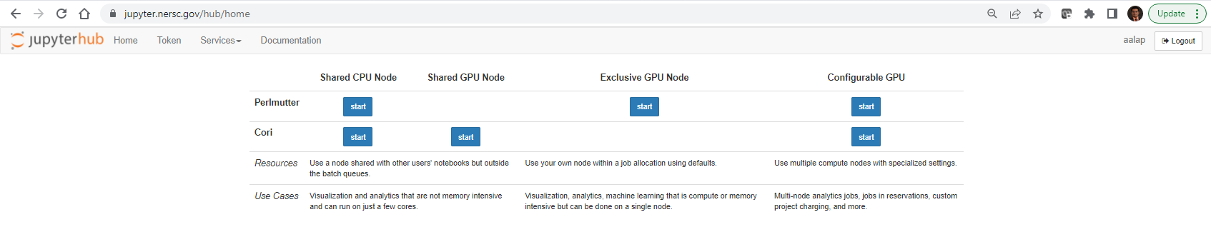
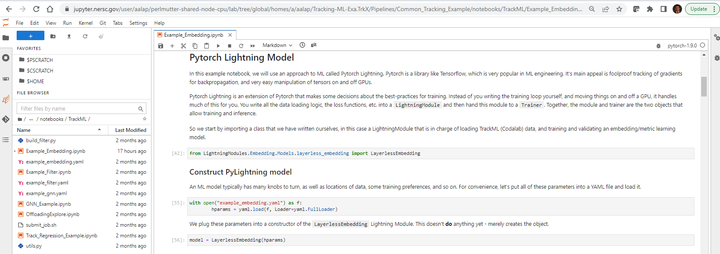
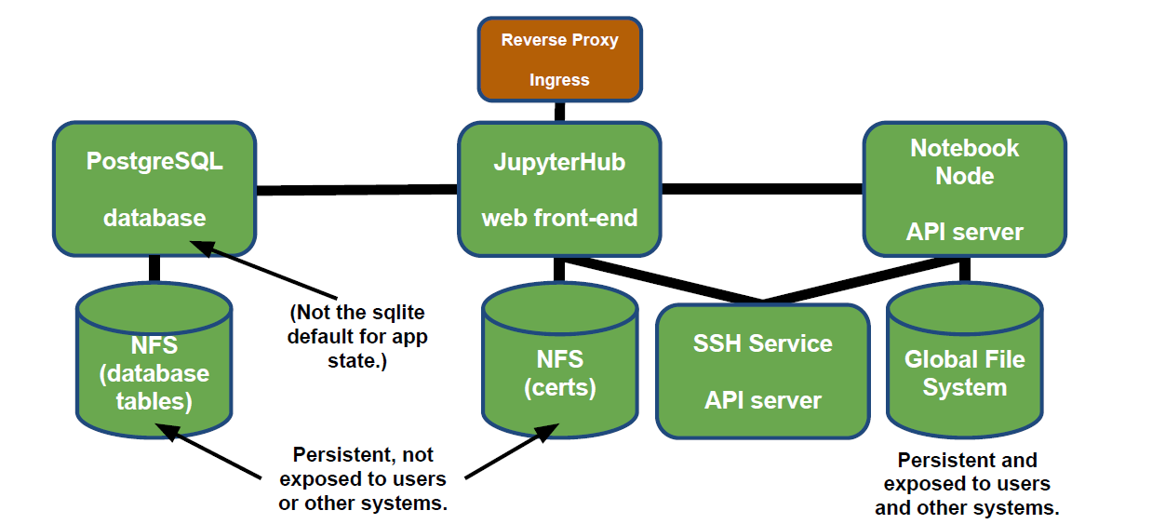
JupyterLab at NERSC
Taking Inspiration from how JupyterLab is delivered to users at NERSC
NERSC Spin (Rancher K8S) Cluster
Source: NERSC Spin Training

Slide 38
METADATA HUB at NERSC?
How to deliver a Metadata Hub for users at NERSC (Future)
Code
CMF Client
Common Cloud Management Services
GitHub
Artifact Stores
(Object Store, Lustre Endpoint, filesystem)
CMF API Gateway
Subscription Service
Web Service
Onboarding
API Manager
Billing
CMF Logging Service
CMF Optimization Service
CMF Query Service
Entitlement
User
Accounts
CMF Core
Accounts
Other…
SQL DB Service
Graph DB Service
NERSC Spin (Rancher K8S) Cluster

